Slide 1

CSE1021- Problem Solving and Programming

Slide 2
Unit-3

Slide 3
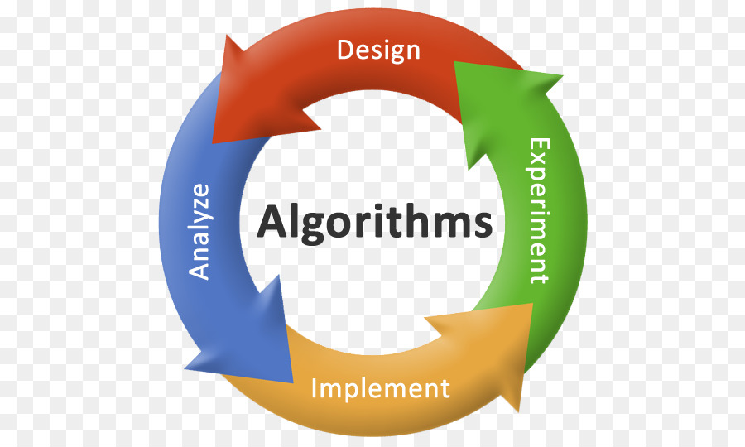
Algorithms
An algorithm is a set of rules that specify the order and kind of arithmetic operations that are used on a specified set of data.
An algorithm is an effective method expressed as a finite list of well-defined instructions for calculating a function.
An algorithm is a finite, definite, effective procedure, with some output
Systematic procedure that produces – in a finite number of steps –
the answer to a question or the solution of a problem.

Slide 4
Essential properties of an algorithm
an algorithm is finite (w.r.t.: set of instructions, use of resources, time of computation)
instructions are precise and computable
• instructions have a specified logical order, however, we can discriminate between
deterministic algorithms (every step has a well-defined successor)
non-deterministic algorithms (randomized algorithms, e.g.)

Slide 5
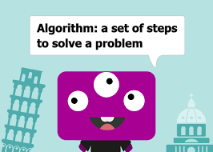
Basic Questions About Algorithms
For each algorithm, we should answer the following basic questions:
• does it terminate?
• is it correct?
• is the result of the algorithm determined?
• how much resources will it use in terms of
• memory? (and memory bandwidth?) • operations?
• run-time

Slide 6
Swapping Two Numbers Using Variable
In many case, programmers are required to swap values of two variables. Here, we shall learn how to swap values of two integer variables, that may lead to swapping of values of any type. Values between variables can be swapped in two ways −
With help of a third (temp) variable
Without using any temporary variable

Slide 7

Swapping Two Numbers Using Variable With help of a third (temp) variable
Logic:
Suppose we take two values in a and b, a=10, b=20 respectively.
temp=a;
a=b;
b=temp;
After the operation of this statement, the value of two variable a and b will be interchanged.
Output:
A=20, B=10;

Slide 8
Algorithm:
Using the temporary variable
Step 1: Start
Step 2: Take the value of variables a and b.
Step 3: Assign the value of variable a into the temp variable.
Step 4: Assign the value of variable b into a variable.
Step 5: Assign the value of variable temp into the b variable.
Step 6: Print the value of a and b.
Step 7: Stop

Slide 9
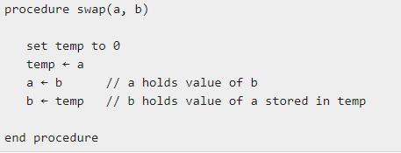
Pseudocode
Using the temporary variable

Slide 10
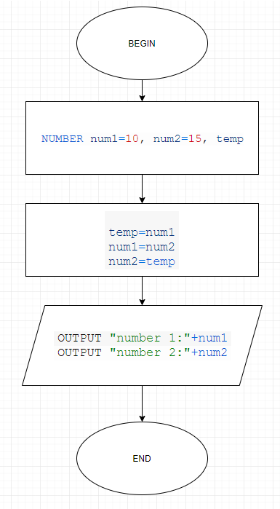
Flow Chart

Slide 11
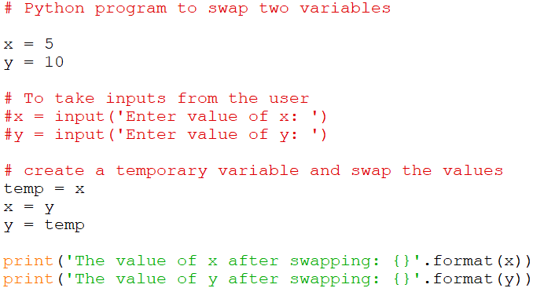
Python Program

Slide 12
Swapping Two Numbers without Using Variable
Here we will use arithmetic operator (+, -). We use addition and subtraction operation on these variables.
a=a+b;
b=a-b;
a=a-b;

Slide 13
Algorithm:
Without Using the temporary variable
Step 1: Start
Step 2: Take the value of variables a and b.
Step 3: Add the values of the a and b and assign it to the variable a.
Step 4: Subtract the values of a and b and assign it to the variable b. (Here the value of a is changed due to the step 3).
Step 5: Subtract the values of a and b and assign it to the variable a.
Step 6: Print the value of a and b.
Step 7: Stop

Slide 14
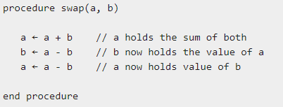
Pseudocode
Without Using the temporary variable

Slide 15
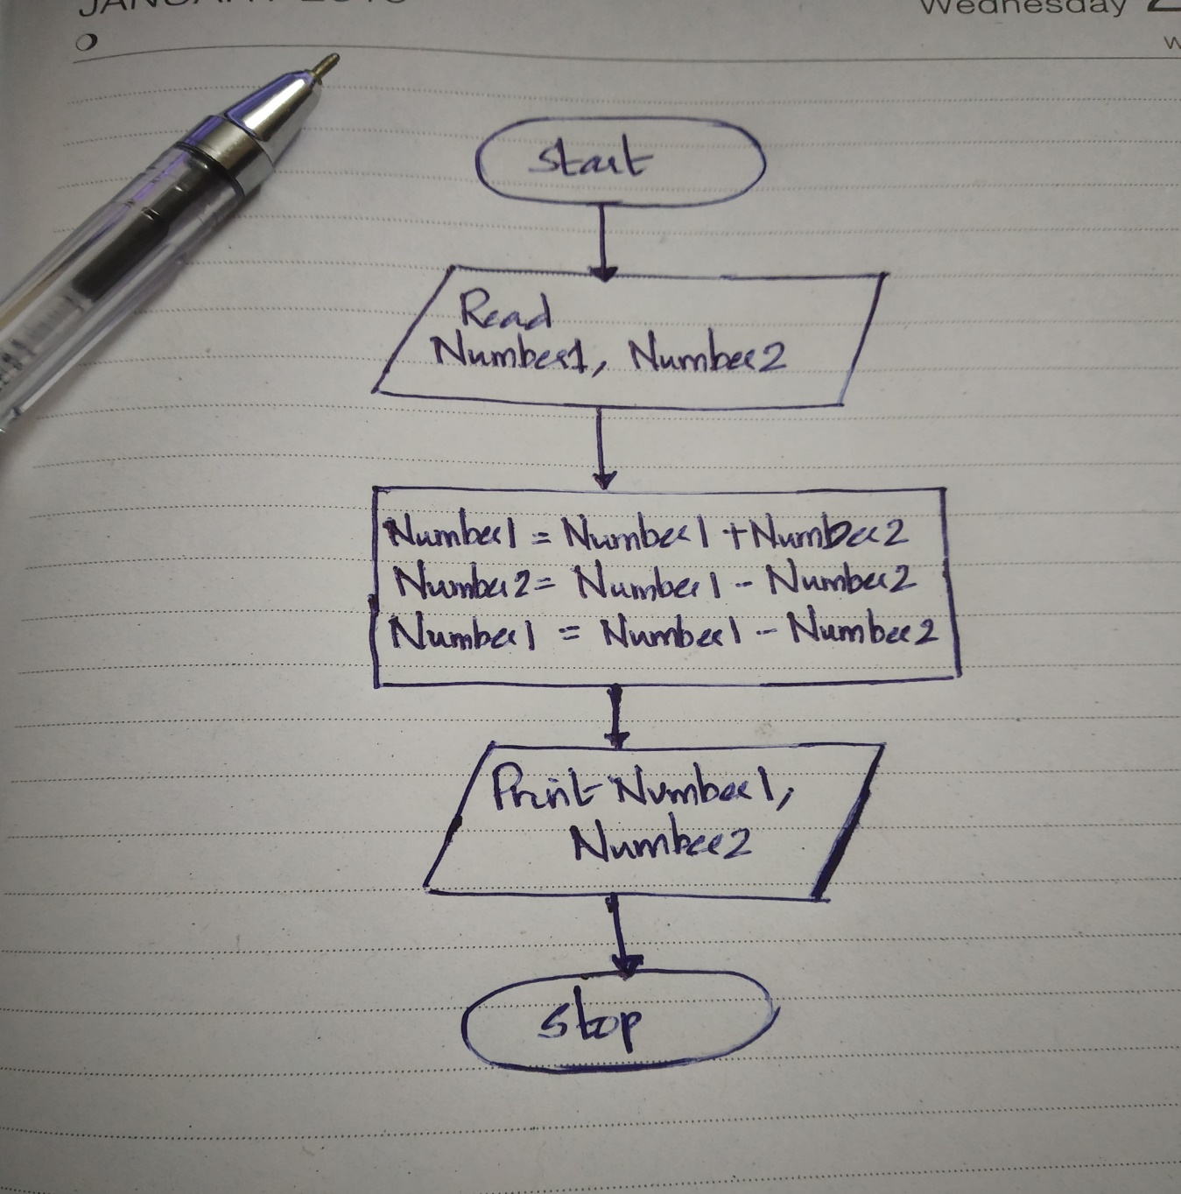
Flow Chart

Slide 16
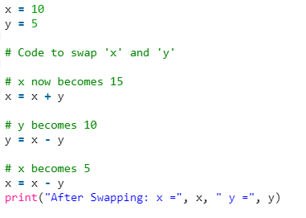
Python Program

Slide 17
Without using third variable and without using arithmetic operator
Here we will use the Exclusive OR bit-wise operator.
Logic:
a=a^b;
b=a^b;
a=a^b;

Slide 18
Algorithm:
Without Using the temporary variable
Step 1: Start
Step 2: Take the value of variables a and b.
Step 3: Operate Exclusive OR operation on variable a and b and assign the exclusive OR output in a variable. (Here value of a is changed)
Step 4: Operate Exclusive OR operation on variable a and b and assign the exclusive OR output in b variable. (Here value of b is changed)
Step 5: Operate Exclusive OR operation on variable a and b and assign the exclusive OR output in a variable. (Here value of a is again changed)
Step 6: Print the value of a and b.
Step 7: Stop

Slide 19
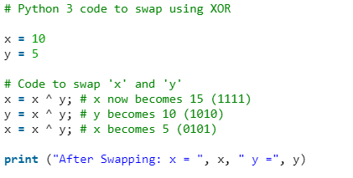
Python Program

Slide 20
Program to count digits in an integer
The integer entered by the user is stored in variable n. Then the while loop is iterated until the test expression n != 0 is evaluated to 0 (false).
After first iteration, the value of n will be 345 and the count is incremented to 1.
After second iteration, the value of n will be 34 and the count is incremented to 2.
After third iteration, the value of n will be 3 and the count is incremented to 3.
At the start of fourth iteration, the value of n will be 0 and the loop is terminated.

Slide 21
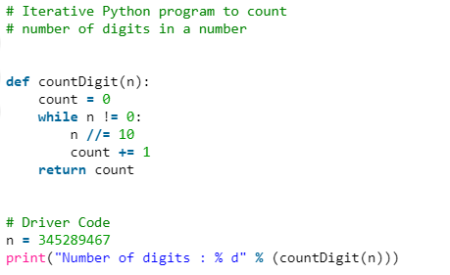
Program to count digits in an integer
Method 1

Slide 22
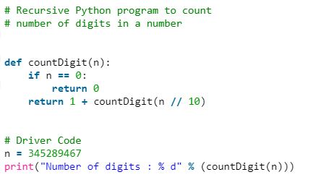
Program to count digits in an integer
Method 2

Slide 23
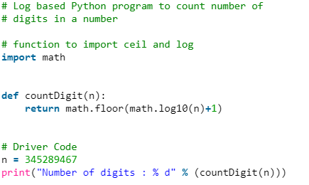
Program to count digits in an integer
Method 3

Slide 24
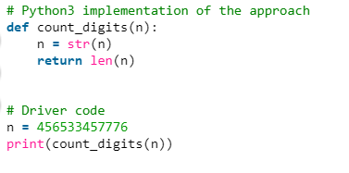
Program to count digits in an integer
Method 4

Slide 25
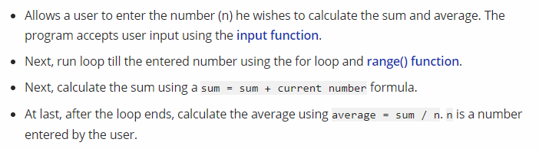
Algorithm: calculate the sum and average of first n natural numbers

Slide 26
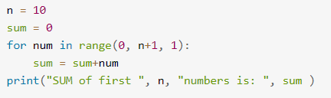
Python Program to calculate the Sum

Slide 27
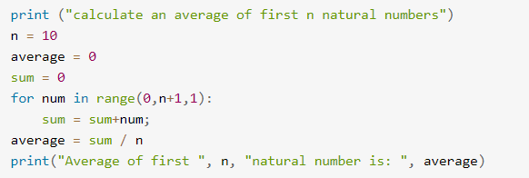
Python Program to calculate average

Slide 28
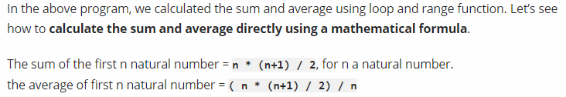
Calculate the sum and average of first n natural numbers using formula

Slide 29
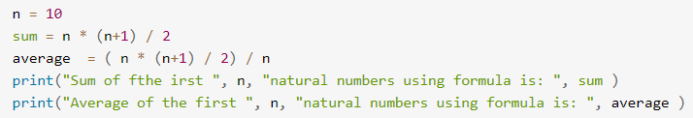
Calculate the sum and average of first n natural numbers using formula

Slide 30
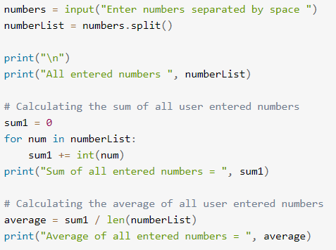
Calculate the sum and average of multiple user-entered numbers

Slide 31
Calculate the sum and average of multiple user-entered numbers

Slide 32
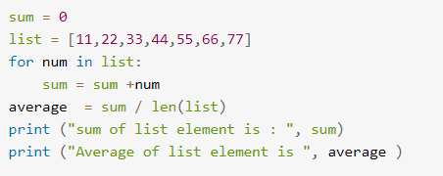
Calculate the sum and average of multiple user-entered numbers

Slide 33
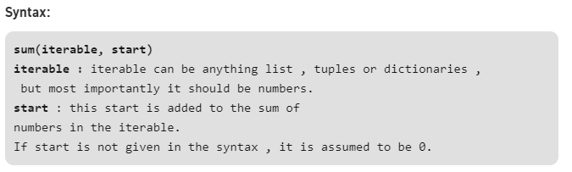
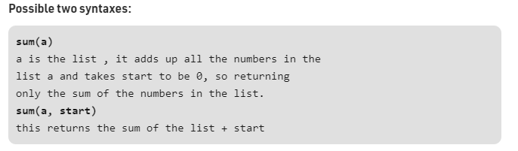
Calculate sum using the built-in sum function in Python
Sum of numbers in the list is required everywhere. Python provide an inbuilt function sum() which sums up the numbers in the list

Slide 34
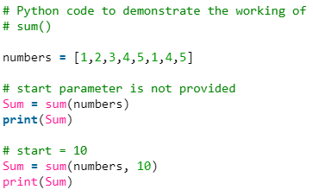
sum() function in Python

Slide 35
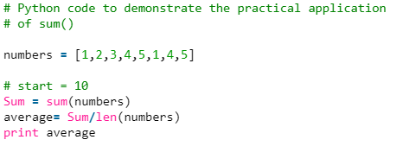
sum() function in Python
Practical Application: Problems where we require sum to be calculated to do further operations such as finding out the average of numbers.

Slide 36
Factorial Computation

Slide 37
Algorithm to calculate factorial value of a number
step 1. Start step 2. Read the number n step 3. [Initialize] i=1, fact=1 step 4. Repeat step 4 through 6 until i=n step 5. fact=fact*i step 6. i=i+1 step 7. Print fact step 8. Stop

Slide 38
Fibonacci Sequence

Slide 39
Algorithm to print Fibonacci series up to given number N
Step 1: Start
Step 2: Declare variables N, N1, N2, N3, i.
Step 3: Read value of N from user.
Step 4: if N < 2, display message “Enter number > 2” and go to step 9.
Step 5: Initialize variables N1 = 0, N2 = 1, i = 0
Step 6: Display N1, N2
Step 7: Compute N3 = N1 + N2
Step 8: Repeat following statements until i < N - 2
Display N3
N1 = N2
N2 = N3
N3 = N1 + N2
i = i + 1
Step 9: Stop

Slide 40
Reverse a Number

Slide 41
Algorithm to Reverse a Number
Step 1:Start
Step 2:Intilize reverse=0
Step 3:Read digit
Step 4:check whether digit>0 then go to step 5 else go to step 9
Step 5:reverse=reverse*10
Step 6:reverse=reverse+digit%10
Step 7:digit=digit/10
Step 8: Go to step 4
Step 9:Print reverse
Step 10: Stop

Slide 42
Base Conversion
Decimal to Any Base
Decimal to Octal
Decimal to Binary
Decimal to Hexadecimal
Binary to Any Base
Octal to any base
Hexadecimal to any base

Slide 43
The Basic Idea
The basic algorithm for this conversion is to repeatedly divide (integer division) the given decimal number by the target base value until the decimal number becomes 0.
The remainder in each case forms the digits of the number in the new base system, however, in the reverse order.

Slide 44
An Upper Limit
The algorithm, in general, will work for any base, but we need digits/characters to represent that many numbers of a base system.
For simplicity, we limit ourselves to base 36 i.e 10 numbers + 26 alphabets.
(We can differentiate lower and upper case, but we intend to focus on the algorithm here!).
It will be clear after the implementation that the method has to work for any base.

Slide 45
Decimal to Base_{x}
Divide the decimal number by the radix of the target base
The remainder from step 1 becomes the value for the current column.
Use the quotient (answer) from step 1 as the decimal value to calculate the next column.
Return to step 1 and repeat until the quotient is zero.

Slide 46
Example – Decimal to Binary
Let's return to the number 237 and convert it to a binary number:
decimal: |  | 237
radix: |  | 2
Decimal |  | Radix |  | Quotient |  | Remainder
237 | / | 2 |  | 118 |  | 1 (2⁰)
118 | / | 2 |  | 59 |  | 0 (2¹)
59 | / | 2 |  | 29 |  | 1 (2²)
29 | / | 2 |  | 14 |  | 1 (2³)
14 | / | 2 |  | 7 |  | 0 (2⁴)
7 | / | 2 |  | 3 |  | 1 (2⁵)
3 | / | 2 |  | 1 |  | 1 (2⁶)
1 | / | 2 |  | 0 |  | 1 (2⁷)
binary: |  | 11101101

Slide 47
Example – Decimal to Hexadecimal
decimal: |  | 3,134,243,038
radix: |  | 16
Decimal |  | Radix |  | Quotient |  | Remainder
3,134,243,038 | / | 16 |  | 195,890,189 |  | E (14) (16⁰)
195,890,189 | / | 16 |  | 12,243,136 |  | D (13) (16¹)
12,243,136 | / | 16 |  | 765,196 |  | 0 ( 0) (16²)
765,196 | / | 16 |  | 47,824 |  | C (12) (16³)
47,824 | / | 16 |  | 2,989 |  | 0 ( 0) (16⁴)
2,989 | / | 16 |  | 186 |  | D (13) (16⁵)
186 | / | 16 |  | 11 |  | A (10) (16⁶)
11 | / | 16 |  | 0 |  | B (11) (16⁷)
hexadecimal: |  | xBAD0C0DE

Slide 48
Decimal to Any Base – Python Implementation
def dec_to_base(num,base): #Maximum base - 36
base_num = ""
while num>0:
dig = int(num%base)
if dig<10:
base_num += str(dig)
else:
base_num += chr(ord('A')+dig-10) #Using uppercase letters
num //= base
base_num = base_num[::-1] #To reverse the string
return base_num

Slide 49
Base_{x} to Decimal
Actually, I have already demonstrated how to convert a number from a base different than ten, into decimal. Once again, here is the complete formula, where c_{x} represents the coefficients at each place-column.
c_{n}·b^{n} + ... + c₂·b² + c₁·b¹ + c₀·b⁰
As an example, let's convert the binary answer back into decimal:
1·2⁷ + 1·2⁶ + 1·2⁵ + 0·2⁴ + 1·2³ + 1·2² + 0·2¹ + 1·2⁰
1·128 + 1·64 + 1·32 + 0·16 + 1·8 + 1·4 + 0·2 + 1·1
128 + 64 + 32 + 8 + 4 + 1
237

Slide 50
Base_{x} to Base_{y}
Is it possible to convert a number from Base_{x} directly to Base_{y} without converting to decimal (base-10) first?
Yes, however, you will need to perform all of your math operations in either Base_{x} or Base_{y}. The algorithms that I have presented are performed with base-10 since that is the number system most people are familiar with.

Slide 51
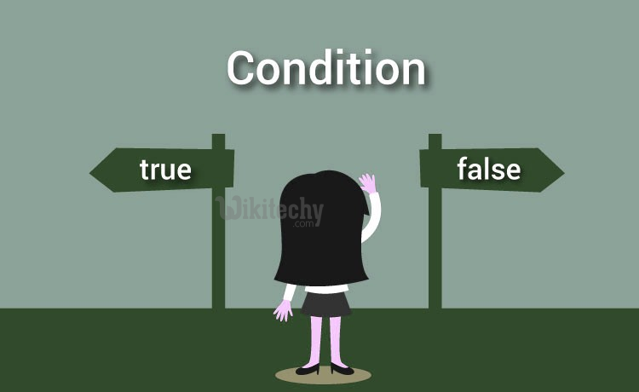
Conditionals
Boolean values and operators, conditional (if), alternative (if-else), chained conditional (if-elif-else); Iteration: state, while, for, break, continue, pass

Slide 52
Boolean
Boolean data type have two values. They are 0 and 1.
0 represents False
1 represents True
True and False are keyword.

Slide 53
Boolean
Example:
3==5 False
6==6 True
True+True
2
False+True
1
False*True
0
Other Examples …….

Slide 54
Operators and Types
OPERATORS: (Discussed in Unit-2)
Operators are the constructs which can manipulate the value of operands.
Consider the expression 4 + 5 = 9. Here, 4 and 5 are called operands and + is called operator.
Types of Operators:
Arithmetic Operators
Comparison (Relational) Operators
Assignment Operators
Logical Operators
Bitwise Operators
Membership Operators
Identity Operators

Slide 55
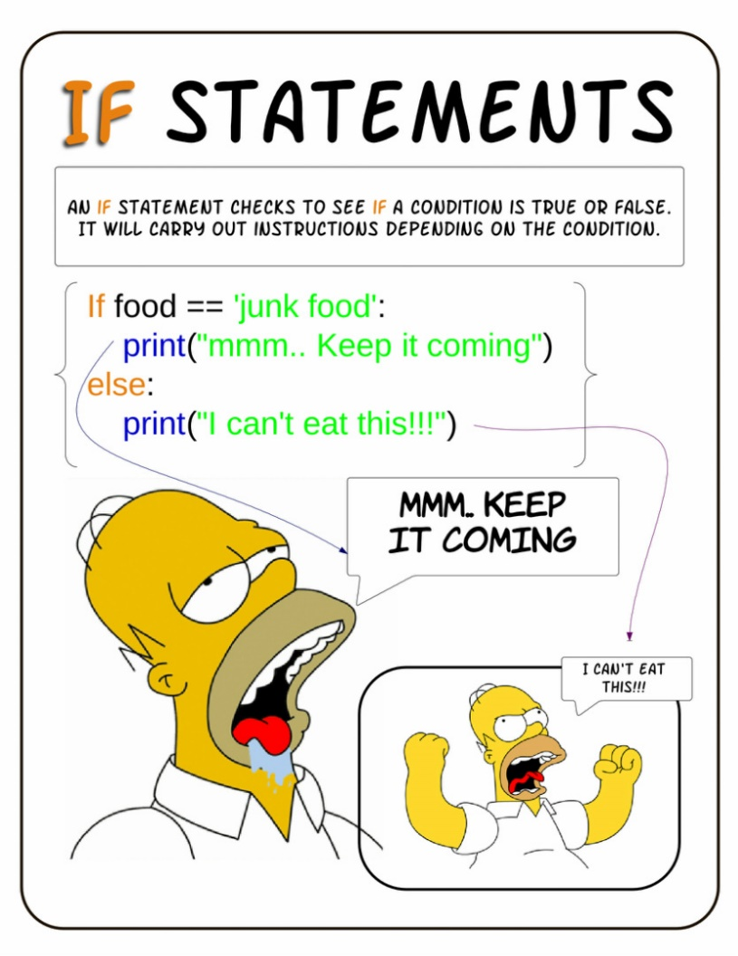
Conditionals
Conditional if
Alternative if… else
Chained if…elif…else
Nested if….else

Slide 56
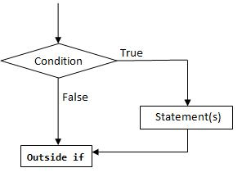
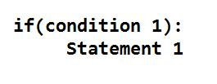
Conditional if
conditional (if) is used to test a condition, if the condition is true the statements
inside if will be executed.
syntax:

Slide 57
Conditional if
Examples ….
Program to provide flat rs 500, if the purchase amount is greater than 2000.
Program to provide bonus mark if the category is sports.

Slide 58
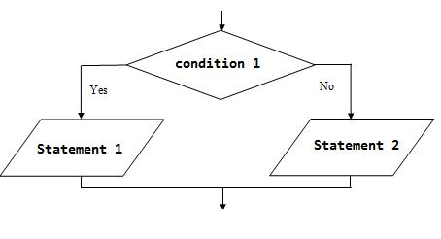
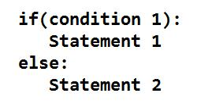
If - Else
In the alternative the condition must be true or false. In this else statement can be combined with if statement. The else statement contains the block of code that executes when the condition is false. If the condition is true statements inside the if get executed otherwise else part gets executed. The alternatives are called branches, because they are branches in the flow of execution.
syntax:

Slide 59
If - Else
Examples …….
odd or even number
positive or negative number
Eligibility for Voting
Greatest or Smallest Number
,…….
…….

Slide 60
Chained Conditionals
The elif is short for else if.
This is used to check more than one condition.
If the condition1 is False, it checks the condition2 of the elif block. If all the conditions are False, then the else part is executed.
Among the several if...elif...else part, only one part is executed according to the condition.
The if block can have only one else block. But it can have multiple elif blocks.
The way to express a computation like that is a chained conditional

Slide 61
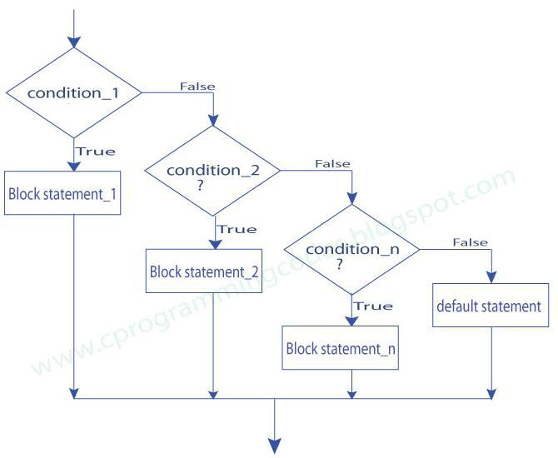
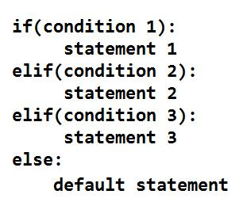
Chained Conditionals
syntax:

Slide 62
Chained Conditionals
Examples ……
student mark system
traffic light system
compare two numbers
roots of quadratic equation

Slide 63
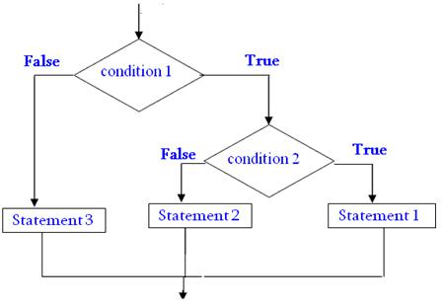
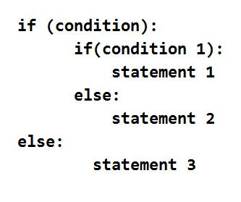
Nested Conditionals
One conditional can also be nested within another. Any number of condition can be nested inside one another. In this, if the condition is true it checks another if condition1. If both the conditions are true statement1 get executed otherwise statement2 get execute. if the condition is false statement3 gets executed.
Syntax:

Slide 64
Nested Conditionals
Examples ….
1. greatest of three numbers
2. positive negative or zero

Slide 65
Iterations and Control Statements
State ?
While
For
Break
Continue
Pass

Slide 66
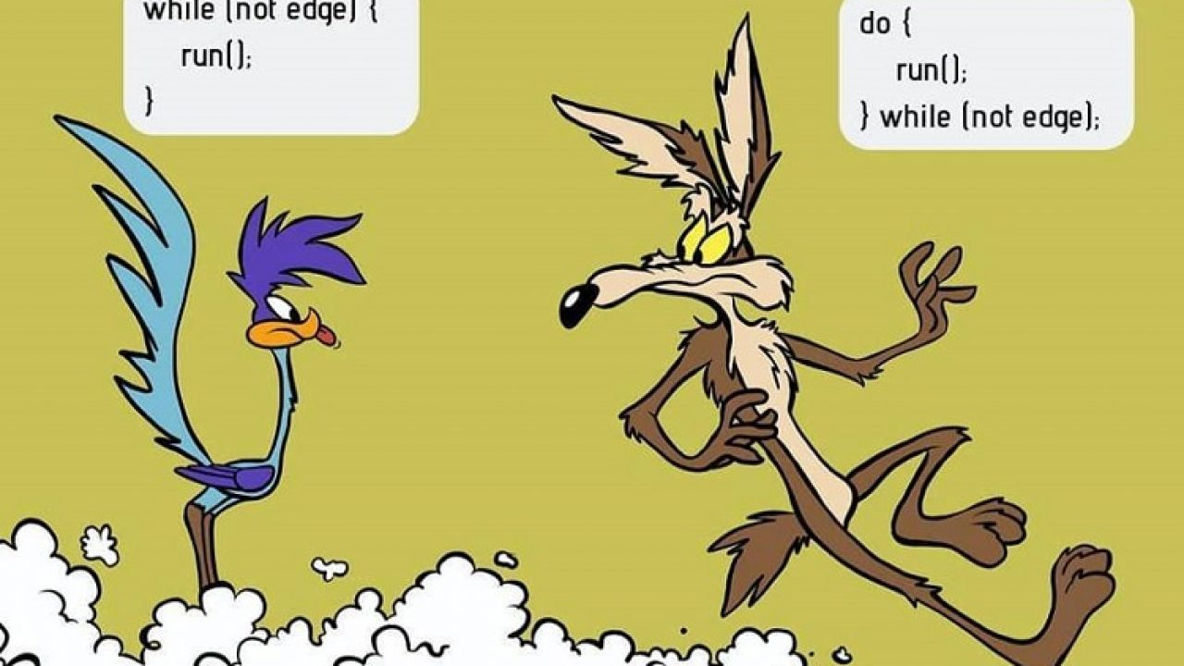
State
Transition from one process to another process under specified condition with in a time is called state.

Slide 67
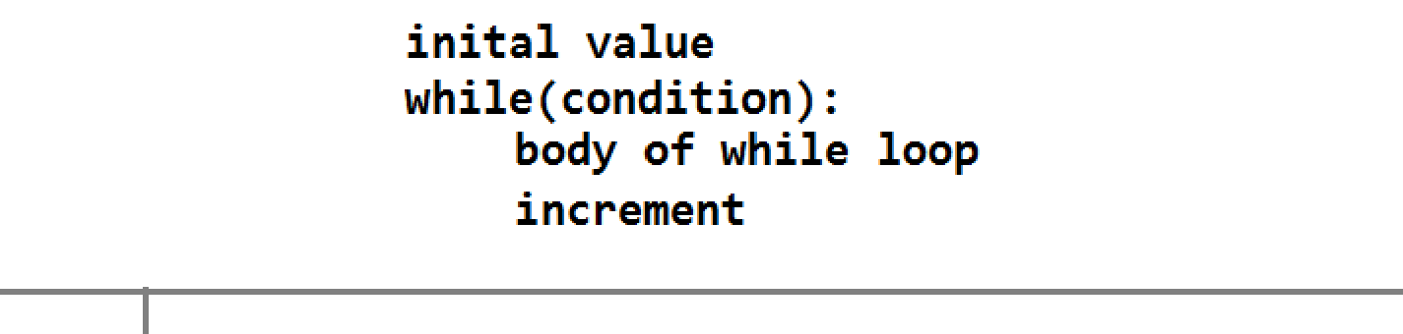
While
While loop statement in Python is used to repeatedly executes set of statement as long as a given condition is true.
In while loop, test expression is checked first. The body of the loop is entered only if the test_expression is True. After one iteration, the test expression is checked again. This process continues until the test_expression evaluates to False.
In Python, the body of the while loop is determined through indentation.
The statements inside the while starts with indentation and the first unindented line marks the end.

Slide 68
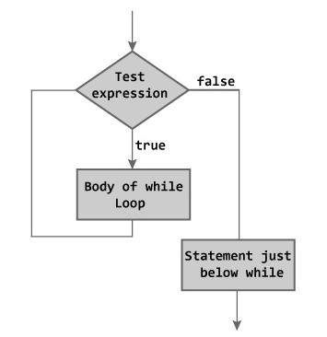
While

Slide 69
While
Examples …….
program to find sum of n numbers:
program to find factorial of a number
program to find sum of digits of a number:
Program to Reverse the given number:
Program to find number is Armstrong number or not
Program to check the number is palindrome or not

Slide 70
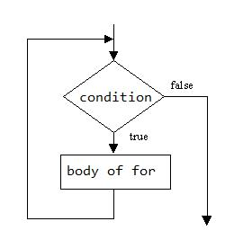
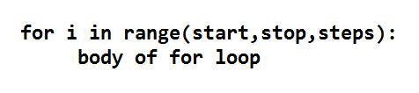
For
for in range:
We can generate a sequence of numbers using range() function. range(10) will generate numbers from 0 to 9 (10 numbers).
In range function have to define the start, stop and step size
as range(start,stop,step size). step size defaults to 1 if not provided.

Slide 71

For
For in sequence
The for loop in Python is used to iterate over a sequence (list, tuple, string). Iterating over a sequence is called traversal. Loop continues until we reach the last element in the sequence.
The body of for loop is separated from the rest of the code using indentation.

Slide 72
For
Examples ……
print nos divisible by 5 not by 10:
Program to print fibonacci series.
Program to find factors of a given number
check the given number is perfect number or not
check the no is prime or not
Print first n prime numbers
Program to print prime numbers in range

Slide 73
Loop Control Structures
Break
Continue
Pass

Slide 74
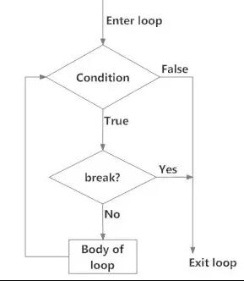
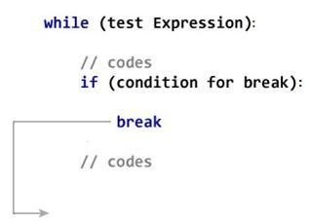
Break
Break statements can alter the flow of a loop.
It terminates the current loop and executes the remaining statement outside the loop.
If the loop has else statement, that will also gets terminated and come out of the loop completely.
Syntax: break

Slide 75
Break
Examples ………

Slide 76
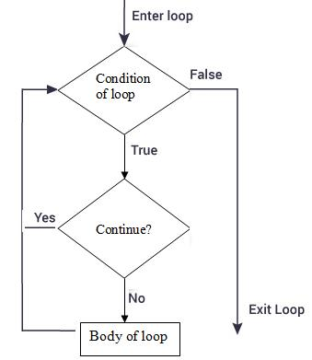
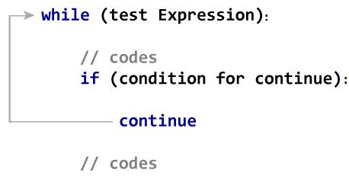
Continue
It terminates the current iteration and transfer the control to the next iteration in the loop.
Syntax: continue

Slide 77
Continue
Examples ……

Slide 78
Pass
It is used when a statement is required syntactically but you don’t want any code to execute.
It is a null statement, nothing happens when it is executed.
Syntax: pass
Examples ……

Slide 79
Difference: Break and Continue
break |  |  |  |  |  | continue
It terminates the current loop and |  |  |  |  |  | It terminates the current iteration and
executes the remaining statement outside |  |  |  |  |  | transfer the control to the next iteration in
the loop. |  |  |  |  |  | the loop.
syntax: |  |  |  |  |  | syntax:
break |  |  |  |  |  | continue
for i in "welcome": |  |  |  |  |  | for i in "welcome":
if(i=="c"): |  |  |  |  |  | if(i=="c"):
break |  |  |  |  |  | continue
print(i) |  |  |  |  |  | print(i)
w |  |  |  |  |  | w
e |  |  |  |  |  | e
l |  |  |  |  |  | l
 |  |  |  |  |  | o
 |  |  |  |  |  | m
 |  |  |  |  |  | e

Slide 80
Examples and Exercises
Few more to learn

